Slide 1

Keystone Landfill Expansion
Prepared for
The Environmental Justice Advisory Board
March 2017

Slide 2
Lackawanna County Landfills
Lackawanna County
Located in Northeastern Pennsylvania
Population: Approximately 215,000
Landfill Facilities
Keystone Sanitary Landfill
  Average Daily Volume: 7,250 tons/day
  Maximum Daily Volume: 7,500 tons/day
Alliance Landfill
  Average Daily Volume: 3,000 tons/day
  Maximum Daily Volume: 5,500 tons/day

Slide 3
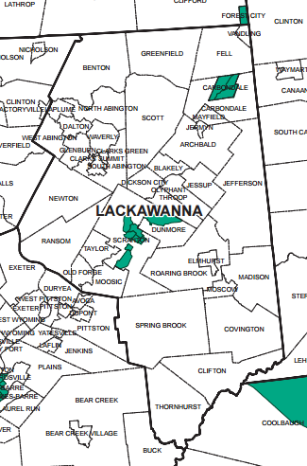
Environmental Justice
The Keystone Landfill is located in a designated Environmental Justice Community

Slide 4
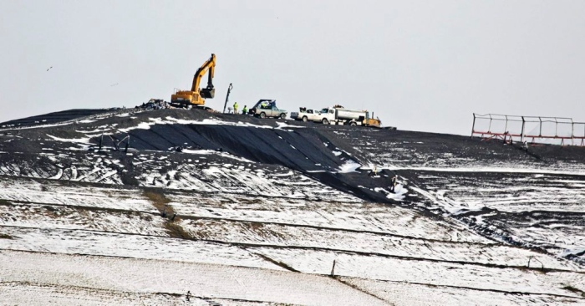
Lackawanna County Burden
100,000,000,000 Pounds
Lackawanna County has already buried over 100 Billion Pounds of waste in its Landfills.
Image Credit: Scranton Times

Slide 5
Lackawanna County Burden
Lackawanna County takes in over 20,000 pounds of trash per resident, per year
This is between 2x to 5x the burden compared to other Pennsylvania counties that have mega landfills
Keystone Landfill’s host communities have the highest population density of any community that hosts large landfills.
  Source: http://thetimes-tribune.com/news/half-of-the-garbage-disposed-of-in-pa-goes-to-five-counties-1.1887458

Slide 6
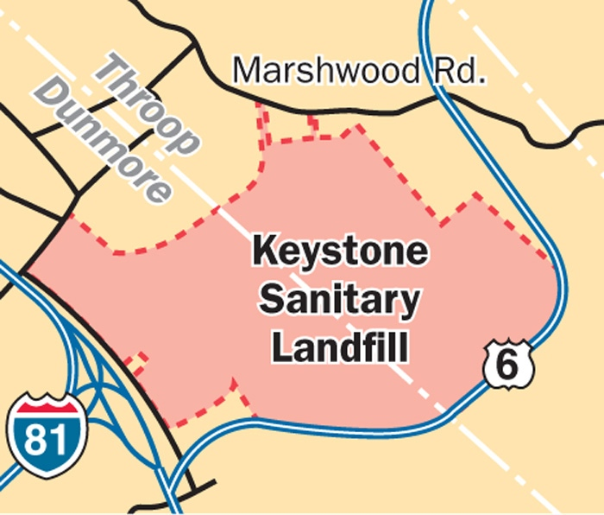
Keystone Landfill Facts
Over 700 acre facility
Has already accepted over 30 million tons of waste
Almost 2/3 accepted waste from out of state
Seeking to expand for over 40 more years and an additional 100 million tons of waste

Slide 7
Identified Problems
Including, but not limited to:
  Groundwater Contamination
  Leachate Spills
  Subsurface fires
  No health studies on surrounding area
  No environmental studies on surrounding area

Slide 8
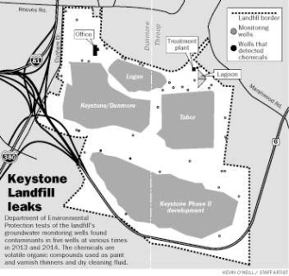
Identified Problem:
Groundwater Contamination
Chemicals leaking into Groundwater for over 14 years.
No resolution.

Slide 9
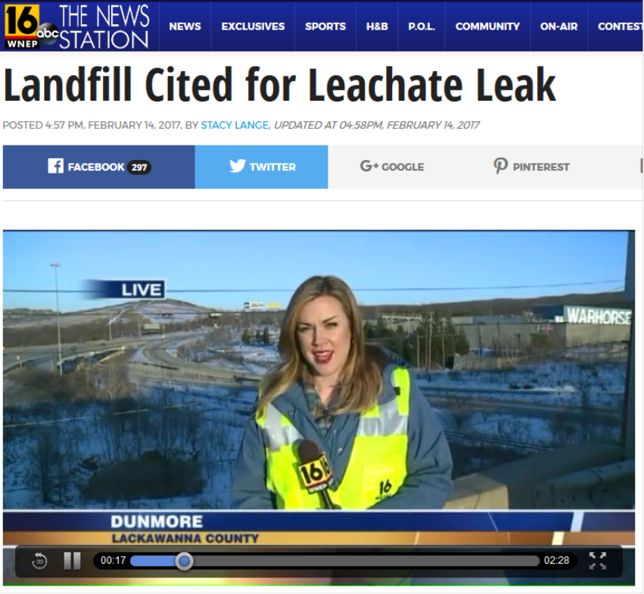
Identified Problem:
Leachate Spills
April 2016:
13,500 gallons spilled
October 2016:
7,000 gallons leaked

Slide 10

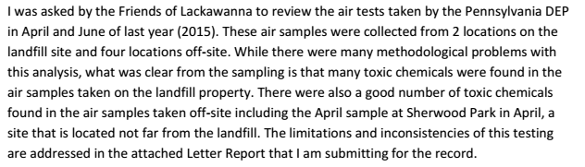

Identified Problem:
Air Quality
Friends of Lackawanna pushed for air samples to be collected and DEP MAU data was provided to outside professional groups

Slide 11
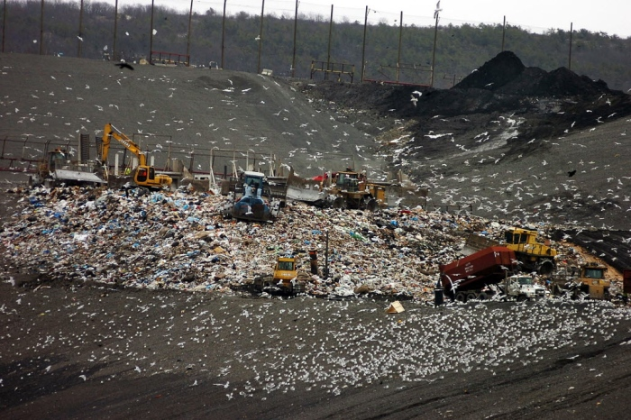
Our One Question
How much burden must one area bear?
Image Credit: Scranton Times

Slide 12
Contact Information
Web & Social
  www.friendsoflackawanna.org
  www.facebook.com/friendsoflackawanna
  www.twitter.com/FOL_tweets
Email
  friendsoflackawanna@gmail.com

